Slide 1
The coolest person on Earth
That’s you!

Slide 2
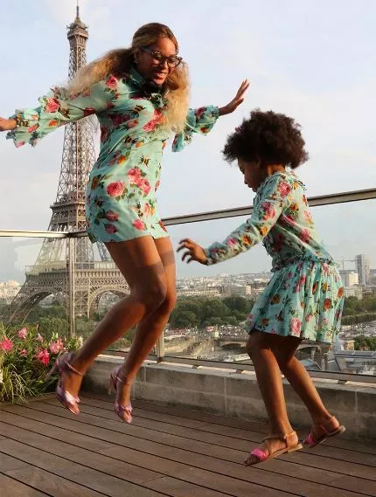
COOLEST PERSON ON EARTH

Slide 3
The coolest person on earth
Who was this person when you were young?
Who is this person to you now?
WHY?

Slide 4
The coolest person on Earth
Is a consistent positive role model
Builds strong positive relationships with youth
Empowers
Encourages youth to participate by modelling and expressing enthusiasm
Afterschool

Slide 5
What is a role model?
In other words…
“Someone who acts like we want to act and says stuff we want to say.”
According to Scott Arizala
“A role model is someone that makes statements (says stuff) and choices (does stuff) that are consistent with good ideas, positive values, and principled beliefs, someone we choose to or are compelled to imitate due to an intrinsic desire for connections and identification.”

Slide 6
What is a Role Model?
Proximity
Similarity
Likeable
Authority
Lessons from the
Bobo Doll Experiment
Notes:
Bobo Doll Experiment dispelled the saying “Do as I say, not as I do.”

Slide 7
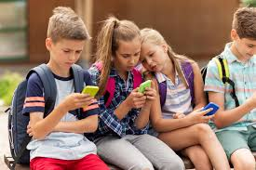
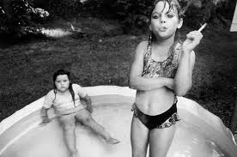
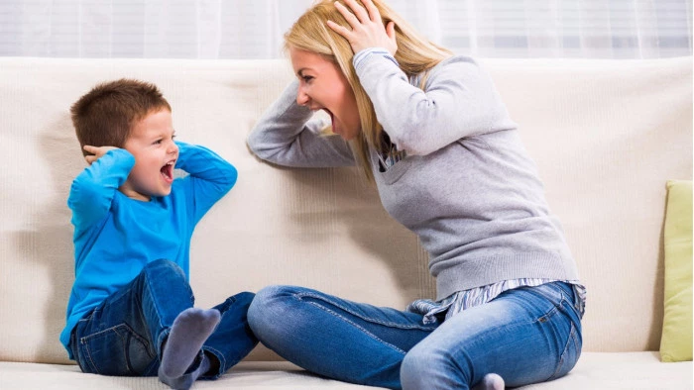
Age 2
Children begin to emulate others as early as

Slide 8
Ages and Stages

Slide 9
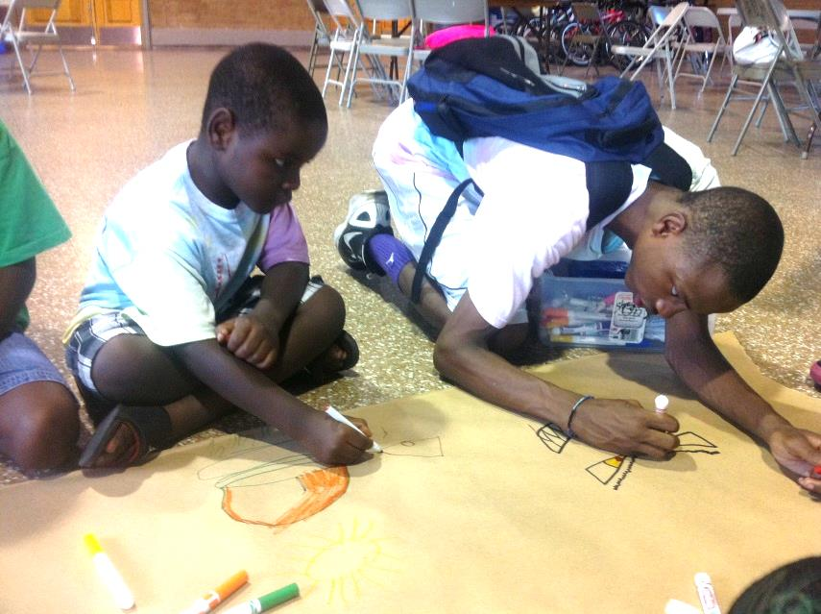
What will youth see and hear from you?

Slide 10
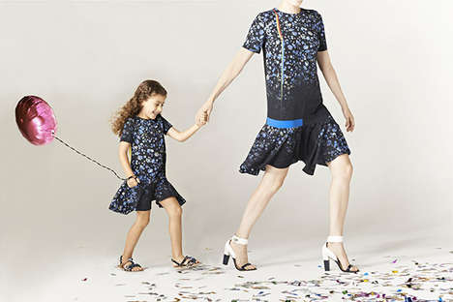
What will youth see and hear from you?
“Man, I can’t wait to get off of this bus.”
“Hey I noticed that you were listening closely to the presentation today.”
“That camper gets on my nerves so bad”
“We have to because Miss Aimee said we do”
Sitting on the sidelines
Missing every basket but still having a great time
Only playing basketball with another counselor

Slide 11
WE DON'T HAVE FAVORITES
WHY? When counselor's show favoritism to campers through being inconsistent with rules or spending more time with a youth, they know they can get by with "bending" the rules.
Notes:
2 min favoritism – recall: set them up for success! If they are a kid you love, set them up for success.

Slide 12
Translation:
WE DON'T ACT LIKE WE HAVE FAVORITES
Questions to Ask Yourself
Why am I getting along so well with these kids?
What is it about the kid or group that is getting to me?
Who do I talk to?
Where do I sit?
When do I smile?
It is important to recognize
and be aware of your
favorites/biases (there is a
reason they are your
favorite), ask yourself why
they are there, and do
something differently
because of it.
Notes:
3 min, favoritism, expectation: not all will be as strong as others, but all will be positive

Slide 13
Building Relationships with youth

Slide 14
Behavior Success
PRACTICE
PRAISE
PRESENT

Slide 15
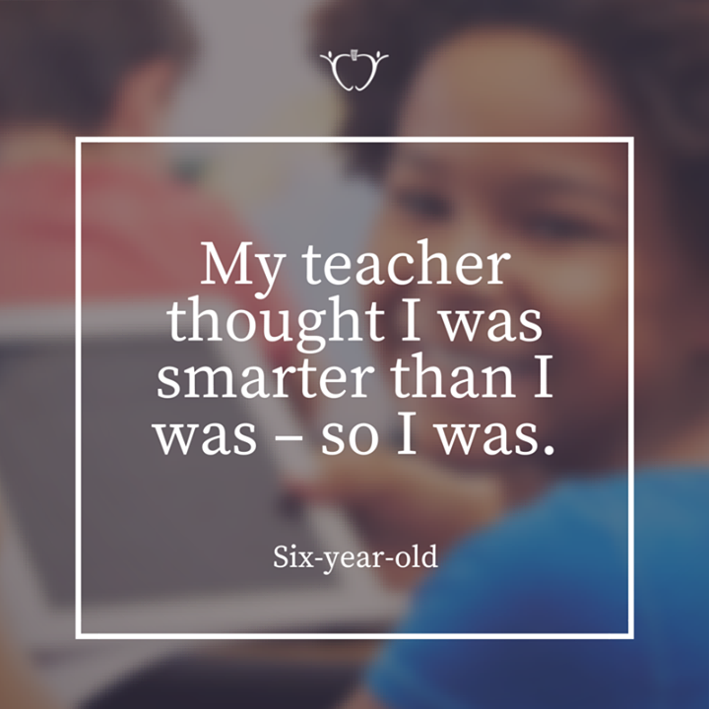
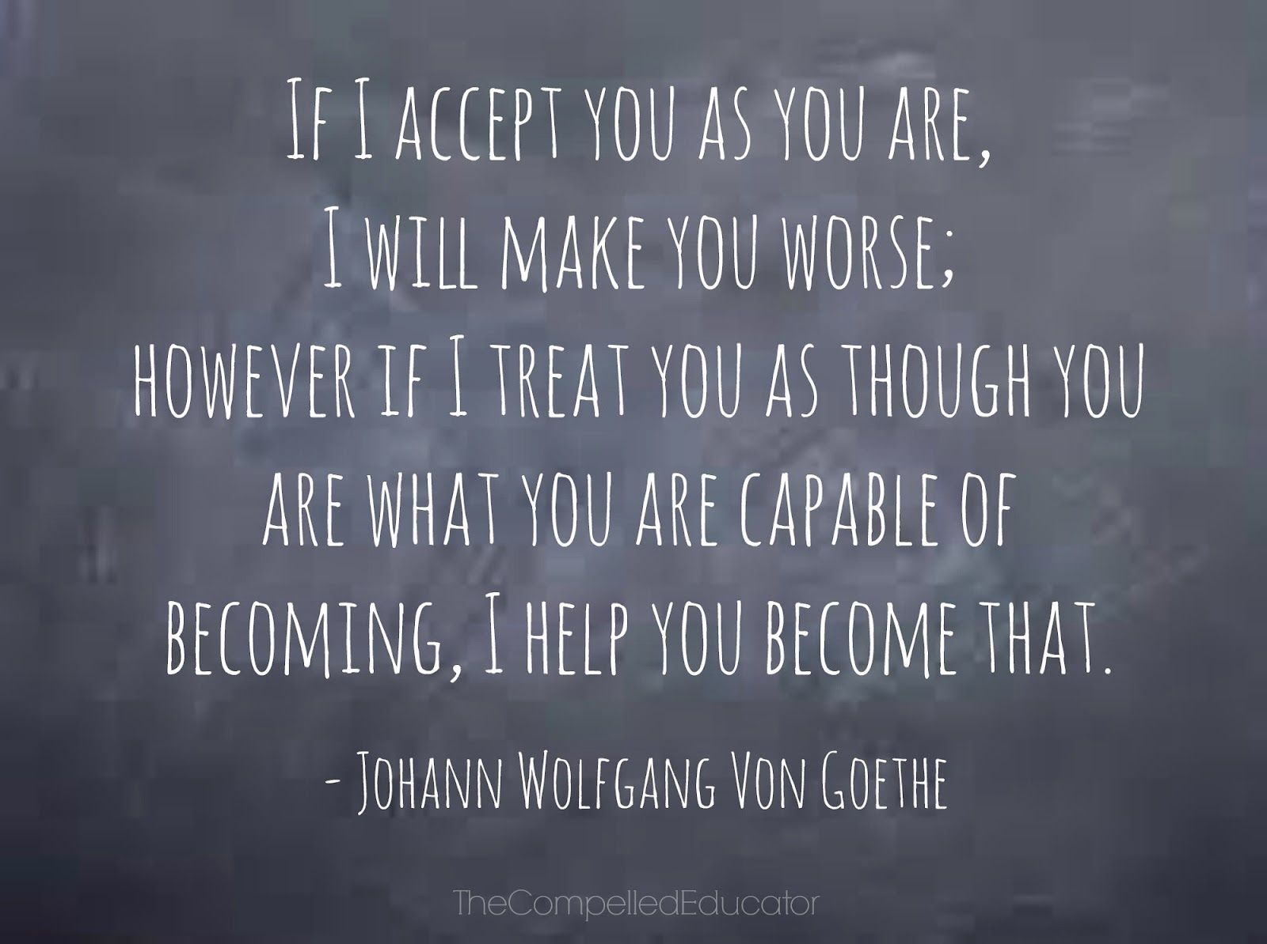
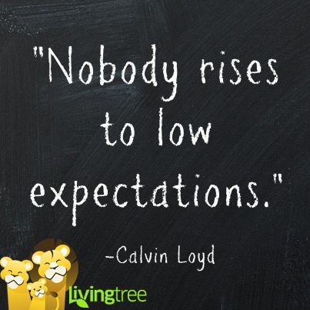
Set students up for success
Holding youth to high expectations does not make you mean. Holding youth to high expectations shows you care.

Slide 16
Thank you
-According to research, having positive relationships with youth is a protective factor for youth, especially with 3 or more (other than parents)
-Positive relationships with youth is a top predicting indicator of how successful a youth program will be.
for being the COOLEST PERSON ON EARTH for young people. You have the opportunity to impact lives.

